Slide 1
Software Development Project-II & Industrial tour
Course Code: CSE-3116
Supervised By
Dr. Mostofa Kamal Nasir
Professor
Department of CSE
MBSTU
Submitted By,
Sifatul Islam
ID: CE-15015
Dept. of CSE, MBSTU

Slide 2
Result Processing System

Slide 3
Objectives of this Project
This project is taken for the purpose of making result sheet for semester final exam.
To manipulate and store result related data of students successfully
Create course-wise Grade Sheet on CT, Theory, Third Exam etc.
Create the Green Sheet of Semester Final tirelessly.
Make the result processing system more reliable and quick.
Make this process more user friendly.

Slide 4
Tools We Use
We Use Microsoft Access and in background we use some sql features too.
Sql Feature we use:
SQL QUERY:
i) Select iii) Make Table
ii) Update iv) Drop
Database Joining:
i) Inner Join iii) Left Join
ii) Right Join iv) Union

Slide 5
What is Microsoft Access :
Microsoft Access is a relational database management system (DBMS or RDBMS). At the very core, it is a software “engine” that provides an interface between physical data and user application queries.
SQL Join:
SQL Join is used to fetch data from two or more tables, which is joined to appear as single set of data.
Types of Join:
1. Inner Join 3. Left Join
2. Right Join 4. Full Outer Join

Slide 6
Features Of This Project
Automatically Calculate the Result within one click after giving input:
We can also Manually Edit the input data.
We can open and Close and Save all the input file at a time.
We can also open all the result sheet within one Click.
By Clicking on “Show me Final Green Sheet”, the green sheet will open in pdf format for printing purpose.
If anybody want to open an individual file that option also available.

Slide 7
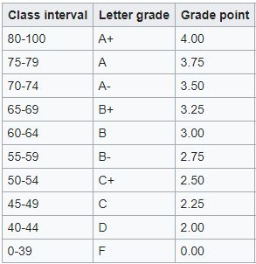
We have 3 types of Course: 1.Theory: Here, we have internal, external and third examinee (when the difference between internal & external is greater than or equal to 20%) marks. Then we calculate our average marks from here. Total Marks = Class participation (10%) + Class Test (20%) + Final Exam(70%)
BACKGROUND STUDY OF EXAM RESULT PROCESSING SYSTEM:
Figure: Grading System

Slide 8
2.Lab: Lab Courses Follow the following way: Total Marks(100%) = Final Practical Exam(40%) + Viva-voce(10%) + Lab Attendance(15%) + Lab Report (15%) + Lab Quiz (20%)
BACKGROUND STUDY OF EXAM RESULT PROCESSING SYSTEM:
3.Project:
Project Courses Follow the following way: Total Marks(100%) = Presentation (30%) + Marks Secured by project Supervisor (70%)

Slide 9
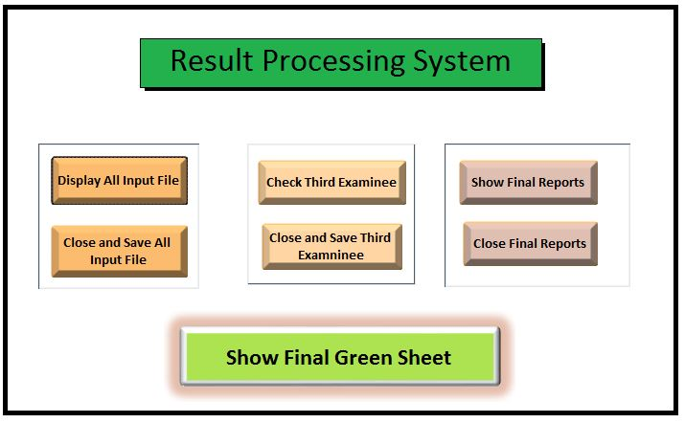
Front End of Result Processing System:
By Clicking this button, all input file will open
All input file will Close and Save
All Third Exam Report and Input will open
All Third Exam file will Close and Save
All Course wise final Report Will Open
All Final Report will Close
Final Green Sheet will open in Pdf Format for Printing Purpose

Slide 10
How We Create this System:
Here, we describe step by step how we create this system :
Step 1: We process each course individually at first. We have 3 type of courses.
i) Theory ii) Lab iii) Project
For theory Course,
We create 2 table “avg” and “ct” for taking input from user.
Then, we create a query named “Third Exam Checker” to manipulate those students who need third Exam.
After taking input of third exam our main process begin.
Query named “average_tmp” calculate the average of final exam from “avg” table, query “cons final” calculate LG, GP, PS etc.

Slide 11
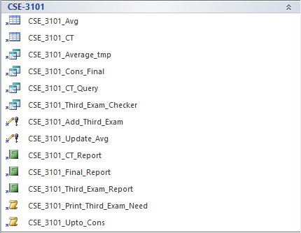
Example of a Theory Course
Here user will give input of Average and CT marks
Here Average Tmp calculate the average, Cons_final Calculate LG, GP, PS etc.
Ct query calculate CT marks and third exam cheker differ the examinee who need third exam
These are update Query
These are Reports of CT , Final and Third Exam
These are macros to show Third exam and Final Report

Slide 12
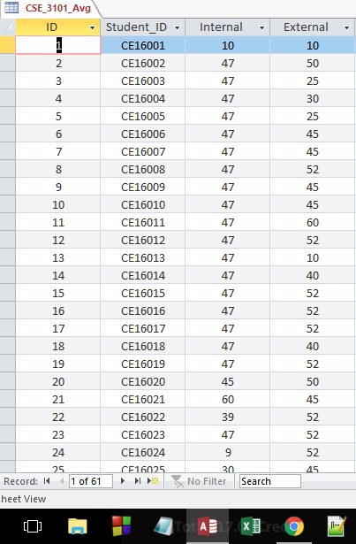
This is an example of an input file. Here, we will take input of internal and external of theory exam. Similarly we will take CT, Lab and Project Marks.

Slide 13
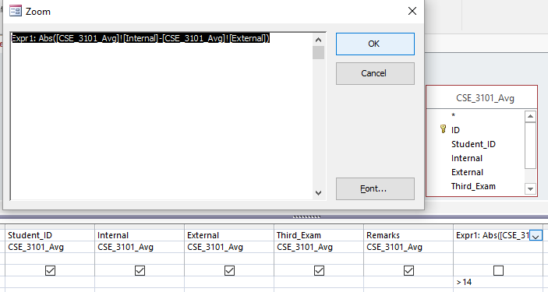
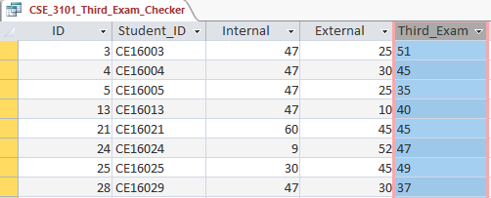
We, Simply Add This Code using Ms Access select query
>=14
Then, We Get This Table which contain only those examinee who need Third Examinee

Slide 14
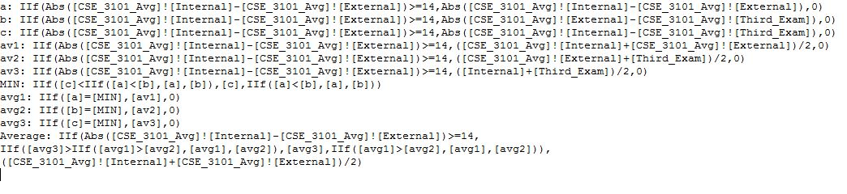
Here ,the query that we use to get the average marks of theory course.

Slide 15
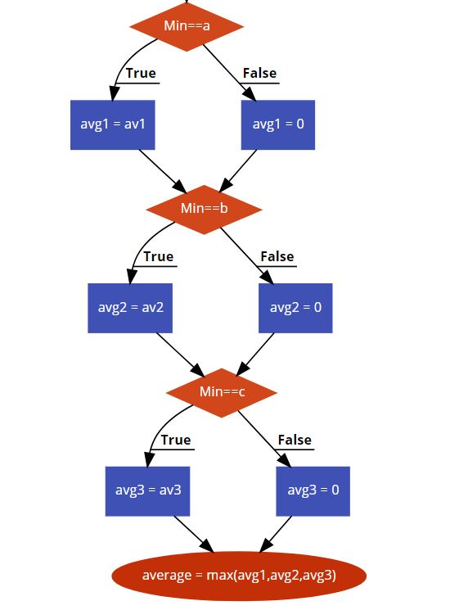
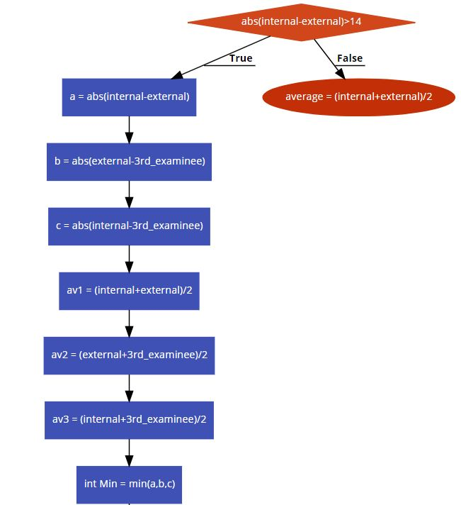
Here, is the flow chart for average code
Abs(internal-external)>=14

Slide 16
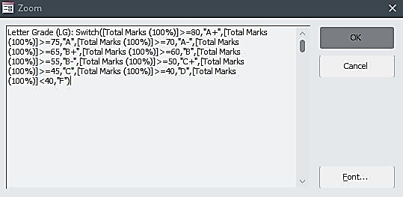
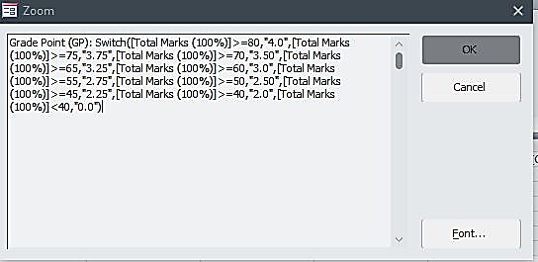
This is the “letter grade” code that we use in the select query.
This is the “grade point” code that we use in the select query.

Slide 17
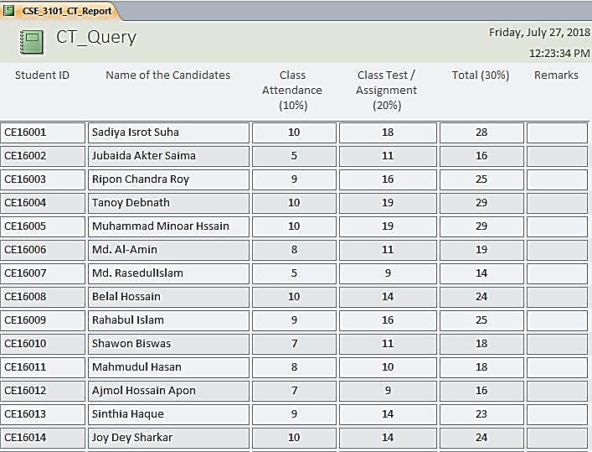
This is an example of an CT report.

Slide 18
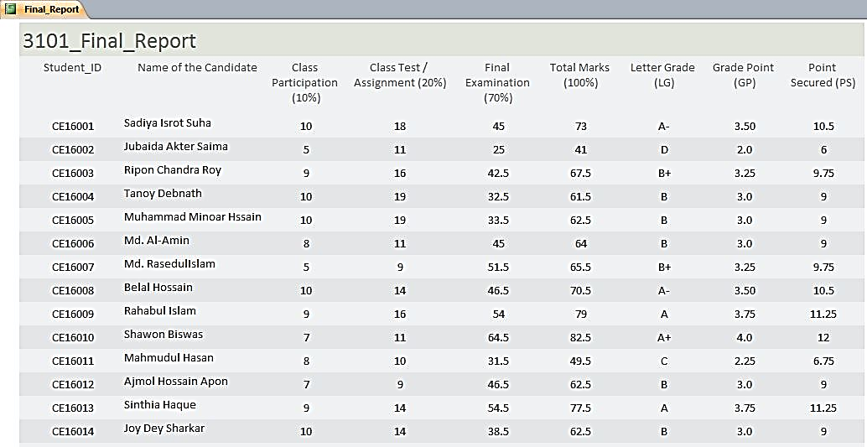
This is an example of an Final report for an individual course

Slide 19
How We Create this System:
Here, we describe step by step how we create this system :
Step 1: We process each course individually at first. We have 3 type of courses.
i) Theory ii) Lab iii) Project
For Lab Course,
We create 2 table “avg” and “ct” for taking input from user.
Query named “avg_query” calculate the viva-voce(10%) and final practical exam(40%)
Query named “ct_query” calculate the Lab-Report(15%), Lab attendence(15%) and Lab Quiz(20%)
Query “cons final” calculate LG, GP, PS etc.

Slide 20
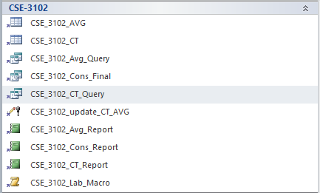
Example of a Lab Course
Here user will give input of Final Prac Exam and Viva Voce and Lab Attendence, Lab Quiz and Lab Report marks
Here “Average_Query” calculate the viva-voce and Final Practical Exam, Cons_final Calculate LG, GP, PS etc. Ct query calculate Lab attendance,Report,Quiz
This is an update Query
These are Reports of avg, ct and final Exam
This is a macro to show Final Report

Slide 21
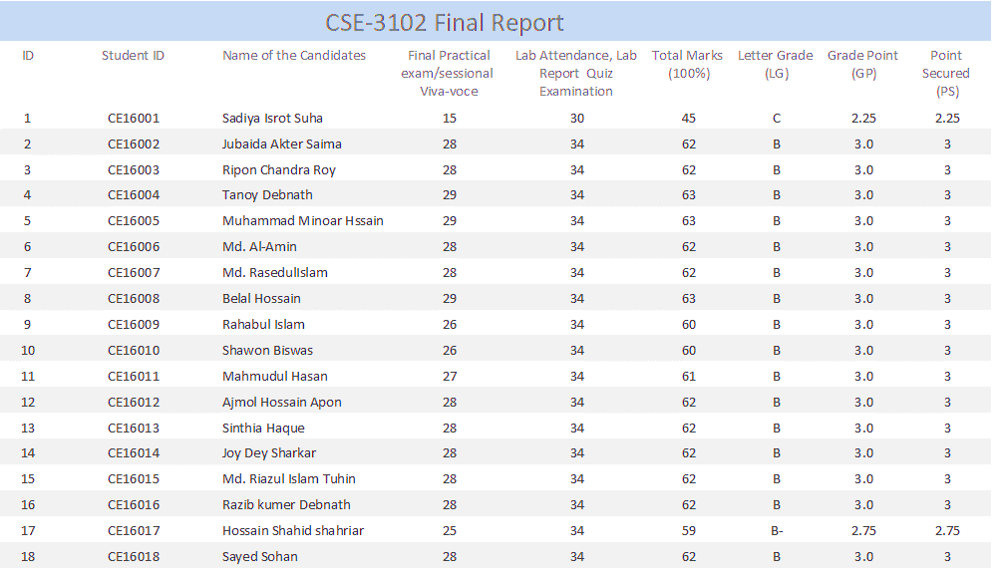
This is an example of an Lab report.

Slide 22
How We Create this System:
Here, we describe step by step how we create this system :
Step 1: We process each course individually at first. We have 3 type of courses.
i) Theory ii) Lab iii) Project
For Project Course,
We create 2 table “Cons” and “ct” for taking input from user.
Query named “Cons Query” calculate the presentation marks(30%) and supervisor marks(70%)
Query “Cons Query” calculate LG, GP, PS etc.

Slide 23
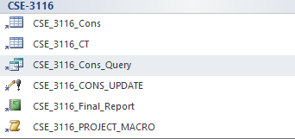
Example of a Project Course
Here user will give input of Supervisor and Presentation marks
Here Cons Query calculate the Total marks, LG, GP, PS etc.
These are update Query
These are Reports of final result
These are macros to show Final Report

Slide 24
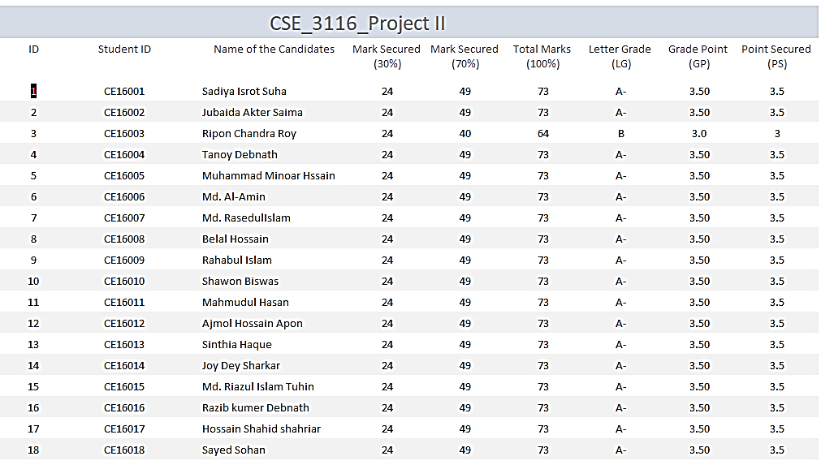
This is an example of an Project report.

Slide 25
How We Create this System:
Here, we describe step by step how we create this system :
Step 2:
Now we create Green Sheet. It’s a long process. We discuss it in brief.
i) We make a query named “Green_Sheet” which inner join all final table of each courses like following picture.

Slide 26
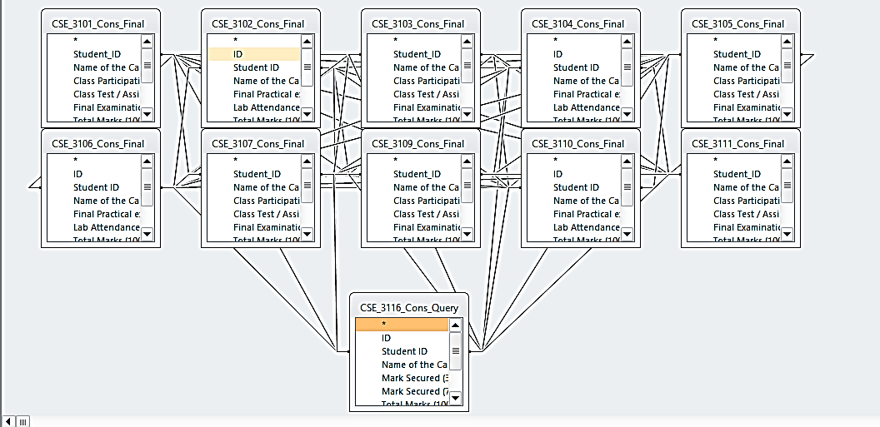
But This is not our Final Green Sheet. Because, This Green Sheet Don’t Contain the examinee who had improve or backlog exam. The Rest Process is described in following slide.
Figure: Inner Join of all Final Table

Slide 27
Step by Step Procedure To Create Final Green Sheet
ULTIMATE FINAL GREEN SHEET
Green Table
3101_Cons_final
FULL JOIN
FULL JOIN
3101_Green Table
3103_Cons_final
3110_Green Table
3116_Cons_final
FULL JOIN
FULL JOIN
3103_Green Table
3105_Cons_final
3106_Green Table
3110_Cons_final
FULL JOIN
FULL JOIN
3105_Green Table
3107_Cons_final
3104_Green Table
3106_Cons_final
FULL JOIN
FULL JOIN
3107_Green Table
3109_Cons_final
3102_Green Table
3104_Cons_final
FULL JOIN
FULL JOIN
3109_Green Table
3111_Cons_final
3111_Green Table
3102_Cons_final
FULL JOIN

Slide 28
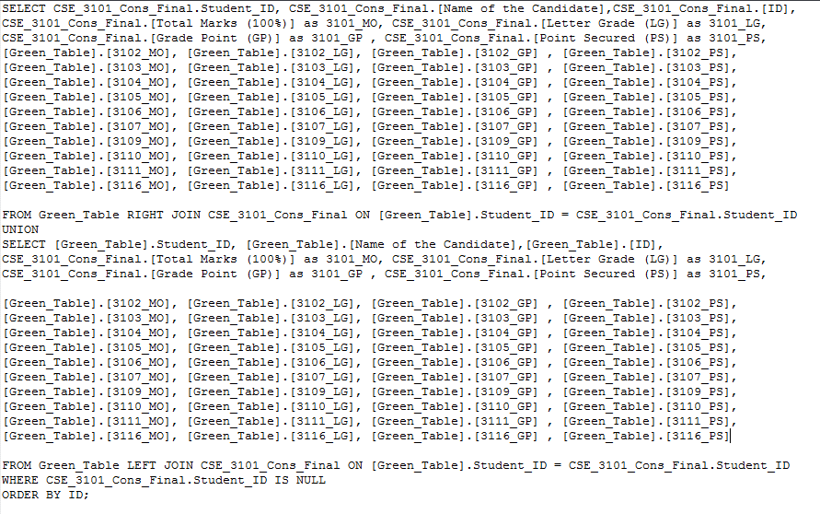
But, MS ACCESS don’t Support Full Join actually. But It Support Union. So in lieu of Full Join we use Left Join, Right Join and then Union.
Here, we do Right Join with Green Table and 3101_Cons_Final
Here, we union Left Join with Right Join
Here, we do Left Join with Green Table and 3101_Cons_Final

Slide 29
How We Create this System:
Here, we describe step by step how we create this system :
Step 3:
Now we Create Some Macros and use these macros to create our front-end. These Macros are:
Input: Here I include all input files
Close Input: Close all input files and save
Third Exam: Open all 3rd exam and close
Close Third Exam: Close all third exam
Final Report: Open all final report
Close Final Report: Close all final report
Final Green Sheet: Show Final Report of green Sheet and open in PDF format.

Slide 30
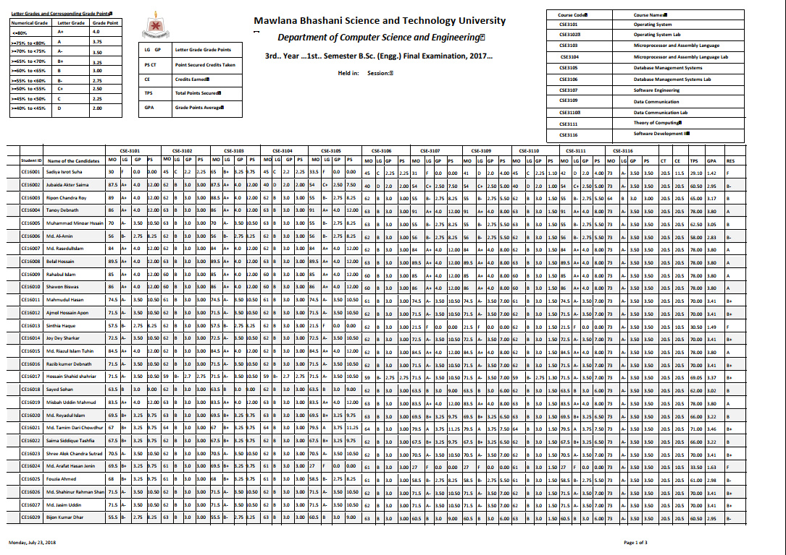
This is our Final Green Sheet

Slide 31
Future Enhancements
Better Database: We will use better database like and use SQL
i) Microsoft Sql Server
ii) Oracle
iii) My Sql
Because, When we will want to apply this system for all department and semester then microsoft access will not be enough.
2. Better Front End: We will use better front end like
i) PHP
ii) HTML
iii) Bootstrap
3. Better Protection: System will get a login ID and Password so that intruder can’t login on the system.

Slide 32
Future Enhancements
4. Combine all semester and department:
All semester and department can be combined so that all information can be stored in a single system.
5. Make transcript for individual student:
This system can make individual grade sheet for the students.

Slide 33
Why choose MS-Access over Excel?
Although there is always overlap, the following rules might help when deciding when / when not to use MS Access:
MS Access is best used for long-term data storage and/or data sharing.
Access is designed for all kind of users.
Data structure and normalization through multiple tables
Adding more records is free
Data and Referential Integrity
Queries and Reports
PA Harris, Vanderbilt University

Slide 34
Limitations of Ms Access
There are some limitations in Ms-Access.
It is difficult to combine all eight semesters results using only MS Access.
MS Access is a small database system so we can not store huge amount of data.
Ms-Access is a database but it is a matter of sorrow that it hardly accept full join of 2 table.(Actually it doesn’t support)
In order to get a better front end we have to use PHP,HTML, Bootstrap along with Ms-Access. We can not have a better front end for this project only using the Ms Access.
Sometimes Ms-Access works too slowly if we want to access large amount of data.

Slide 35
Motivation
Currently, the result processing is a lengthy process with complex system. So, We decide to make a project to make this process automatic hence we create this project to make our result processing system swift and easy.

Slide 36
CONCLUSIONS:
The main aim of this project was to put
whatever was learnt in access, into practice.
And the result obtained was a result
processing system , in addition to a new
Microsoft office tool learnt. Also it provided a better
understanding of database.
This project helped in gaining confidence in
writing the query and joining.

Slide 37

Questions

Slide 38
Thanks Everyone !

